Slide 1
Smart noise judgment for quality test of X-Ray tube SXVT X-Ray Tube Project T CED INW-CN | April,2022

Slide 2
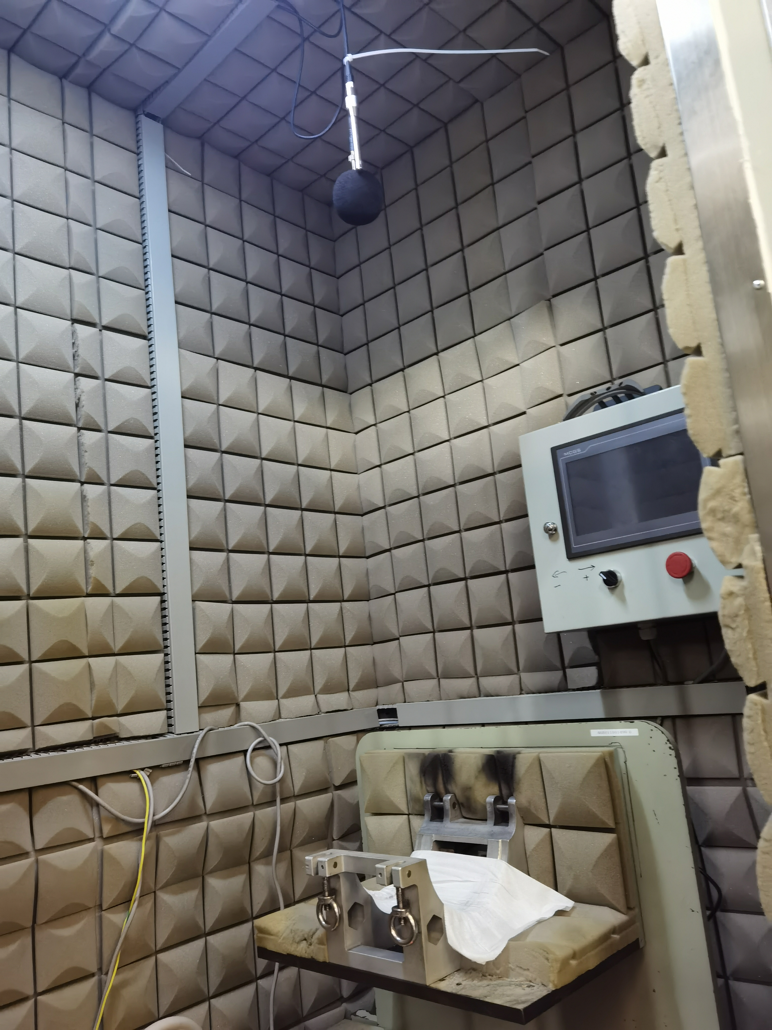
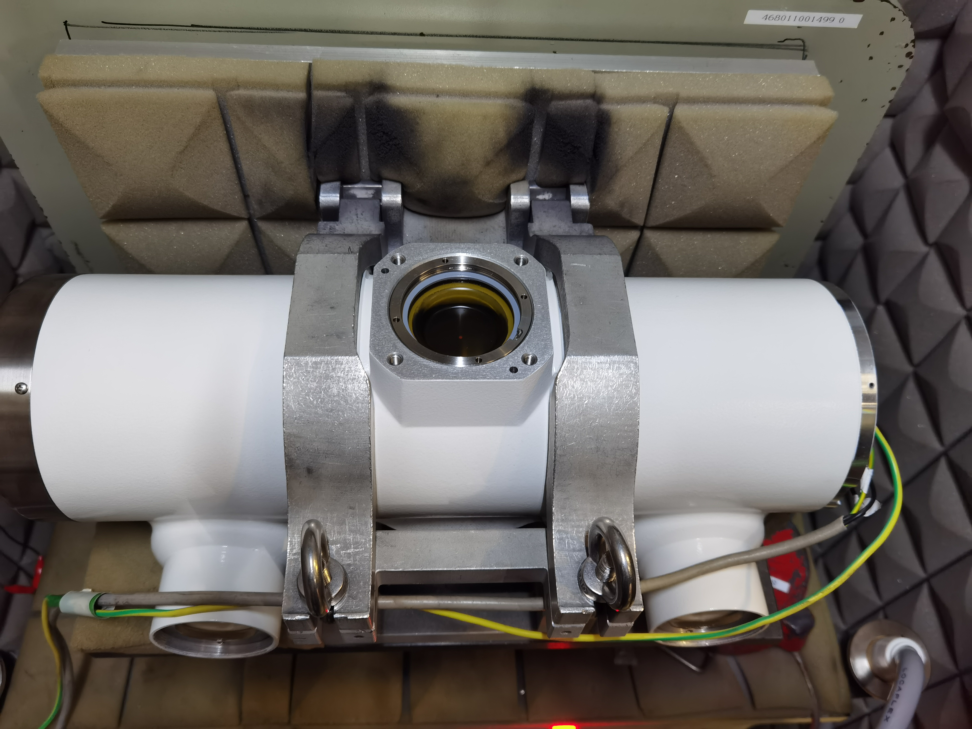
Smart noise judgment for quality test of X-Ray tube
Page 2
Restricted | © Siemens 2022 | YU HE | T CED INW-CN

Slide 3
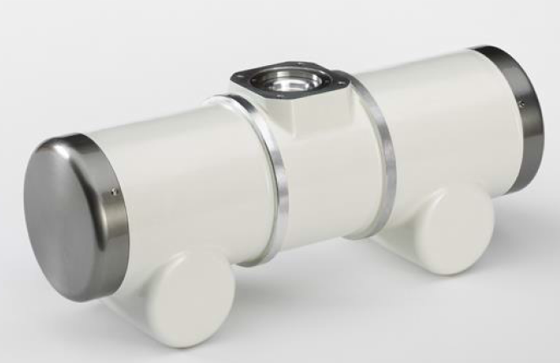

Introduction
Background
- SXVT Tube is the important part of X-ray machine.
- Typical failure types are Noise, Bearing(Anode) stuck, Shaft-broken.
- Currently test in noise test room by sound-meter, record an observation with single number value.
- Need an objective standard to judge the quality of the X-Ray Tube.
Target
- 记录/存储 当前产线测试房的 旋转管的噪声测试数据.
- 探索并分析 XTA的噪声数据，确定信号特征.
- 构建实时分析模型，对测试的XTA 提供客观噪声合格与否的判断结果.
- 产品噪声质量追溯应用.
XTA
Page 3
Note: Picture only for reference
Restricted | © Siemens 2022 | YU HE | T CED INW-CN

Slide 4
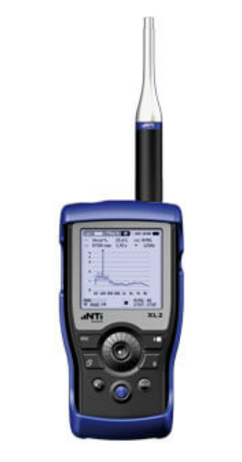
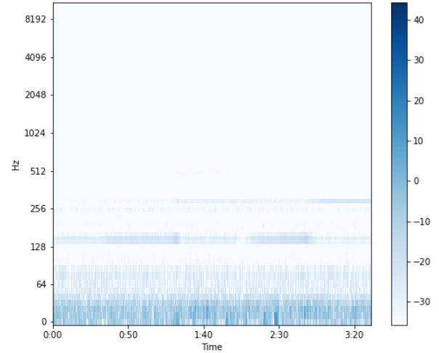
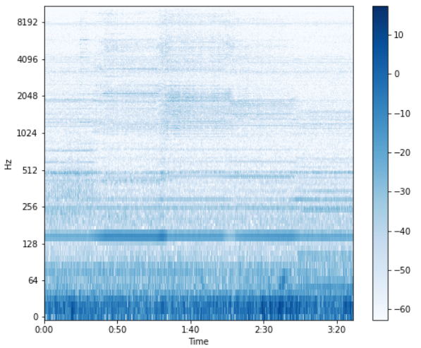
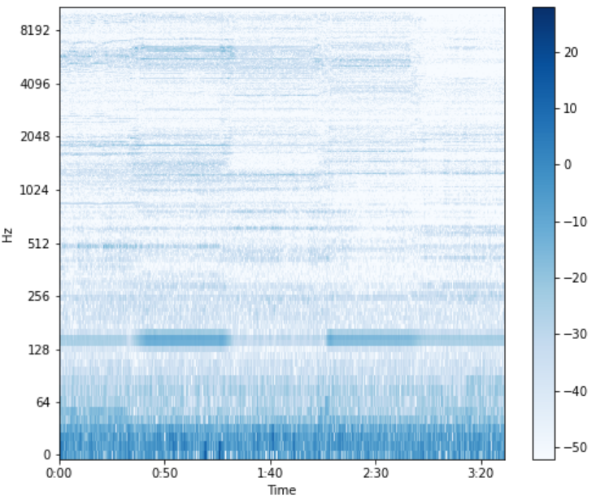
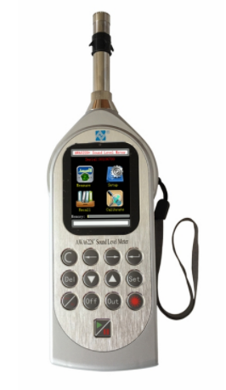

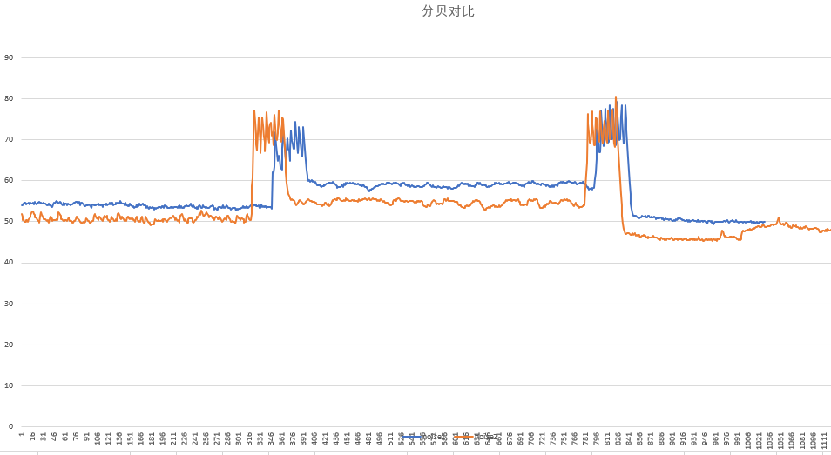
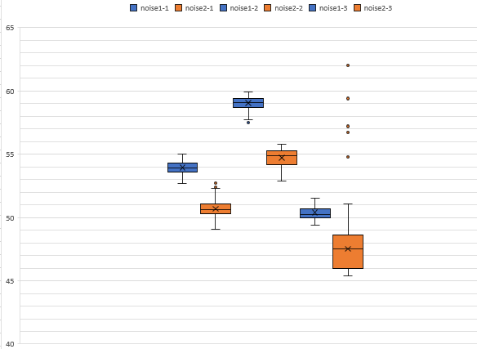

Feasibility Analysis
Data Features
Data Acquisition
Insight of noise data features (based on sound files)
Spectrogram analysis of sound signals (analogue data, incl phone’s recording, NTi and AiHua Sound Meter)
Explore DA Solution for on-site sound data
Considering factors: ensure real-time, sampling frequency, effort and cost.
Nti XL2
Aihua AWA6228+
Digital (discrete) data is the basis for features extraction
good
abnormal
high
Difference of frequency spectrum energy
Difference stability in data
Page 4
Restricted | © Siemens 2022 | YU HE | T CED INW-CN
Amplitude
Distribution

Slide 5





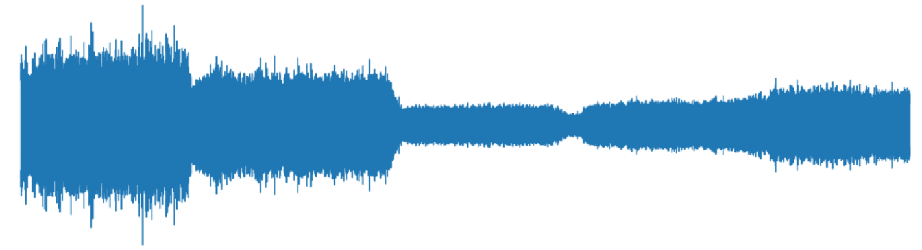

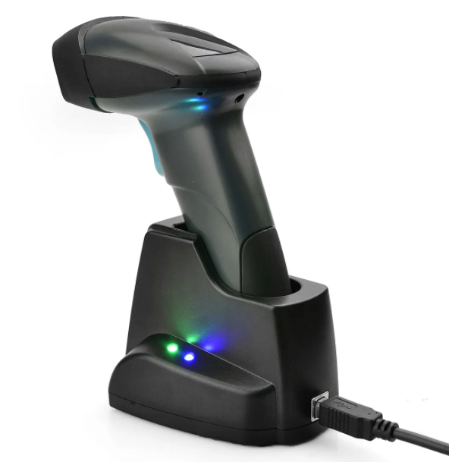
Solution Overview
Services/Apps
质量归因分析 应用
噪声质量测试 客户端
支持用户基于产品编号和时间查询测试数据，和客户端分析结果
实现对时间周期内的产品质量的统计和分析展示
串口控制及通信
基于Client交互控制，准确记录各转向的测试数据（消除脏数据干扰）
展示当前测试的数据
分析结果（Normal/Abnormal）提示
Web
Service
On-Site
6
5
2
Edge Level
数据收集 & 边缘计算
4
Server / PC
配置及数据获取
时序数据存储
统计与分析
事件分析/判断
3
Field Level*
Mic
1
Test Bench
Product ID
Test Room
Sound Meter
AWA6228+
Page 5
* Take one test room as example in the architecture
Restricted | © Siemens 2022 | YU HE | T CED INW-CN

Slide 6
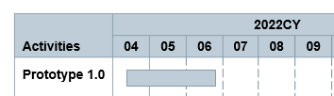
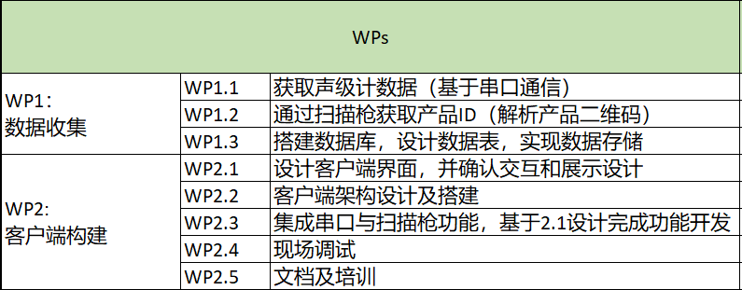
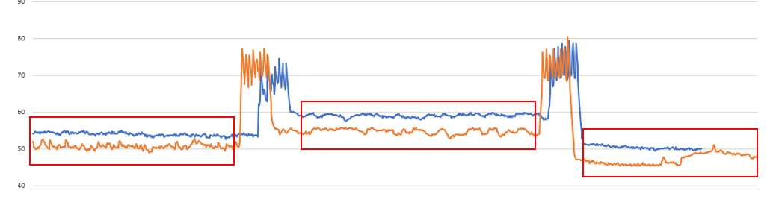
Prototype 1.0 构建完成 现场Client端的 功能部分
Services/Apps
噪声质量测试 客户端
串口控制及通信
基于Client交互控制，准确记录各转向的测试数据（消除脏数据干扰）
展示当前测试的数据
分析结果（Normal/Abnormal）提示
Target：
实现现场的有效测试数据的存储
On-Site
2
Edge Level
数据收集 & 边缘计算
4.1
Cost：
￥253,000 （先完成一个静音房），
后续可以+2w 完成另一个静音房的集成
Server / PC
配置及数据获取
时序数据存储
3
Field Level*
Mic
1
Test Bench
Product ID
Test Room
Sound Meter
AWA6228+
Page 6
* Take one test room as example in the architecture
Restricted | © Siemens 2022 | YU HE | T CED INW-CN

Slide 7
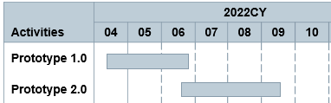
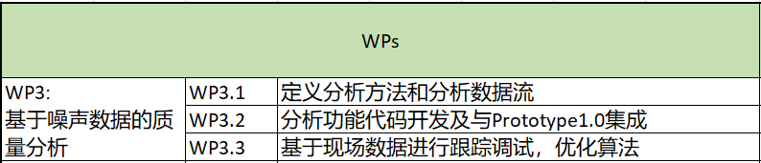
Prototype 2.0 现场Client端 集成数据分析
Services/Apps
噪声质量测试 客户端
Cost：
￥234,000 , Ray和SDR类型产品
串口控制及通信
基于Client交互控制，准确记录各转向的测试数据（消除脏数据干扰）
展示当前测试的数据
分析结果（Normal/Abnormal）提示
On-Site
5
Edge Level
数据收集 & 边缘计算
4.2
*：建议基于1/3 OCT 输出各频带值进行分析
Server / PC
配置及数据获取
时序数据存储
统计与分析*
事件分析/判断
Target：
实现信号特征分析，提供客观的基于数据的分析判定结果
Page 7
* Take one test room as example in the architecture
Restricted | © Siemens 2022 | YU HE | T CED INW-CN

Slide 8
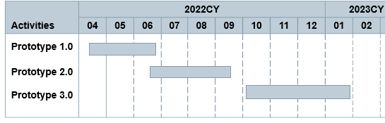
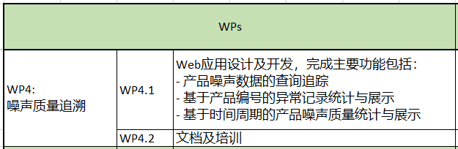
Prototype 3.0 产品噪声质量追溯 应用
Services/Apps
质量追溯 应用
支持用户基于产品编号和时间查询测试数据，和客户端分析结果
实现对时间周期内的产品质量的统计和分析展示
Web
Service
6
Edge Level
数据收集 & 边缘计算
Server / PC
配置及数据获取
时序数据存储
统计与分析
事件分析/判断
Target：
从数据的角度，实现产品数据追溯，统计噪声质量记录，直观展示
Cost：
预估￥409,500
Page 8
* Take one test room as example in the architecture
Restricted | © Siemens 2022 | YU HE | T CED INW-CN

Slide 9
Support Needed and Risk
Support Needed:
IT support: establish demo IT environment, including local network and internet.
Hardware support: sound-meters and micro-phone ready, RS232 line, ToUSB connector.
Software support: sound-meter’s functions package.
X-Ray tube expert support: explain tube’s real scenario and the discuss failure mode, like good / bad noise of X-Ray products.
Engineer support: support on-site test and help to provide test data and information, especially the failure data in multi-types.
Requirement definition and discussion: from business view define requirement and confirm on solution workflow and UI design.
Risk:
Sound-meter’s functions package data quality and impacted by environment.
Less of different product types whole status mode and data.
Requirement of service-design still need clarify.
Page 9
Restricted | © Siemens 2022 | YU HE | T CED INW-CN

Slide 10
Questions?
Answers!

Slide 11
Contact
Published by Siemens
T CED INW-CN
Expert
YU He
200, Linghu Avenue 214135, Wuxi China
Mobile: +86 18921506861
E-mail: yu-he@siemens.com

